Slide 1
Optimism for Offenders: An Avenue to Reentry
A Tax Credit Opportunity for Vermont Business
A presentation by Cassidy Gooding & Cory Woerner
Notes:
I was thinking something with alliteration. Like. Catalyzing Convicts or something. I had trouble finding the least offensive word for convict, though. Offender? Felon? Lol

Slide 2
Faceless Felons

Slide 3
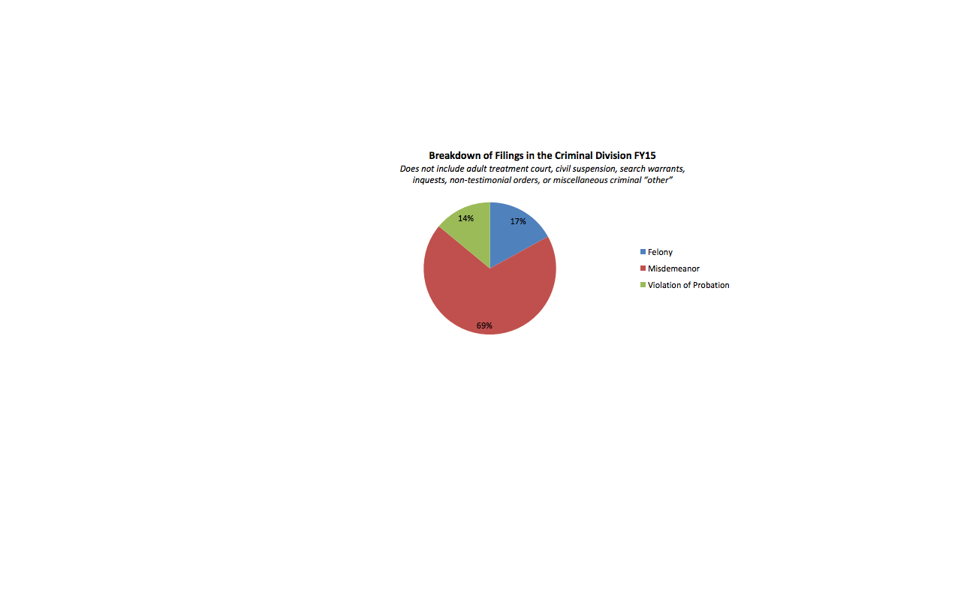
Faceless Felons
According to the VT DOC Annual Report, published Jan. 2016:
18,000 criminal cases opened
$62k per prisoner per year average
Vermont prisons at average 95% capacity
51.6% recidivism rate for moderate to high-risk offenders

Slide 4
Creepy Convicts

Slide 5
Scrubbing Away the Stigma
Buying into traditional attitudes toward felons only hurts community as a whole
Recidivism has a high toll on tax-payers and offenders alike
Making offenders feel part of the community again helps them stay out of trouble

Slide 6
The Recently Released Offender Tax Credit
Opportunity for Vermont businesses to gain tax credit for hiring recently released offenders
Modeled after existing credit
Avenue for offenders to reenter their communities
Notes:
Is this what we want to definitely name it? I figure the less we put on these slides the better, since we only have 10 minutes. Maybe just key bullet points here that we can expand on?

Slide 7
Purpose of the Credit
Reduce recidivism rates in Vermont
Begin erasure of social stigma toward offenders
Help businesses maintain workforce
Fosters welcoming community for offenders with gainful relationships & sense of duty
Notes:
Feel free to add more purposes. I figured we can just take turns speaking about the different stats. Also, purpose or goals?

Slide 8
Section a
A qualified employer shall be eligible for a nonrefundable credit against the income tax liability imposed under 32 V.S.A. chapter 151 in an amount equal to [$2,000] for each new full time employee hired after the passage of this act, for a position the majority of the duties of which are at a business location within Vermont. The Employer shall be eligible to receive the credit for [3 years] following the date of hire.

Slide 9
Section b
A recently released offender shall be eligible for a nonrefundable tax credit against the income tax liability imposed under 32 V.S.A. chapter 151 in an up to a total of [$1,200] for each month of the calendar year {$100/month} in which he/she is employed by a qualifying employer under §a. The employee shall be eligible to receive this credit for [3 years] following the date of hire.

Slide 10
Feasibility
The Recently Released Offender Tax Credit is based on the successful Veteran’s Tax Credit, passed in 2011. The Veteran’s Tax allows businesses that hire recently deployed vets to collect a tax credit.
Notes:
I have been looking for an article to say something about the efficacy of this tax but will keep doing so. Basically here we will say that this isn’t a crazy idea because x amount of vermont businesses have been successful using the veteran credit and ours is super similar.

