Slide 1
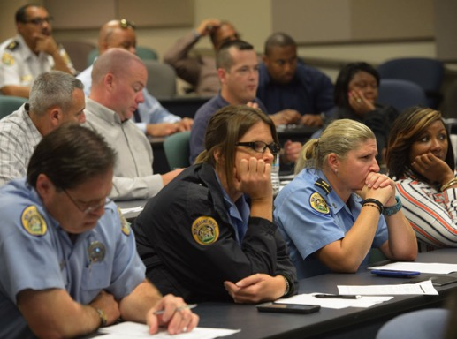
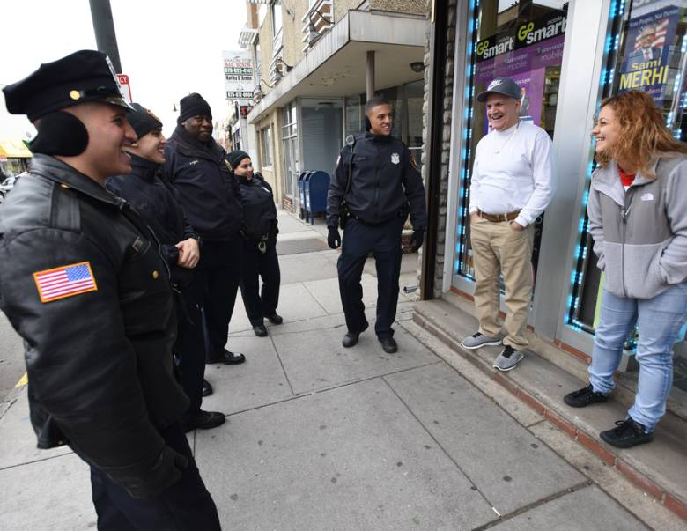
Police-Community Integrated Training and Education (P-CITE)
A Not-So Original Idea for Facilitating and Strengthening the Dialogue between Police and the Community

Slide 2
Core Issues
Lack of Cultural Understanding Between Police and Community
I.e. District of Columbia MPD –demographics do not match. Suburban and exurban individuals are in charge of policing urban communities with a completely different demographic to which they only have a professional relationship, but no real personal relationship or investment in.
“New officers from out of town are coming with their own values and morals,” says an officer who isn’t authorized by the MPD to comment. “They may not understand what life is like in some of our neighborhoods.”
Current strategy is to have police forces correspond with the demographics that they police i.e Galax, VA hires Spanish speaker to be able to establish a human connection “understand the cultural nuances” of the increasing Spanish speaking community. Take it one step further and foster what makes that cultural connection so key, and that is personal understanding.
Lack of Accountability or Perceived Lack of Attention
Deep and burning desire for actual accountability (requires knowing your voice is being heard)
Erosion of Community Trust in Police
Lack of Dialogue concerning perceived threats on both sides.

Slide 3
Increasing Trend Towards Community Police Training…
As early as 1994 the US DOJ established the Community Oriented Policing Services (COPS) Branch.
Mostly outreach events or isolated training workshops.
Now we need to take a step forward and expressly train police recruits with the help of the community.
"A belief or intention held by the police that they should: (1) Consult with and take account of the wishes of the public in determining and evaluating operational policing policy and practice; and (2) Collaborate with the public whenever possible in solving local problems." – Koch and Bennett
“Call to re-establish close community relationships. According to them we have passed through the "political" era (with intimate police and community relations) and the "reform" era (with professionally neutral and distant relationships).” – Kelling and Moore

Slide 4
Proposal Overview
Goal:
Bring a comprehensive community-policing training program to the Vermont Police Academy
Directly involve non-police, non-academics in training.
Engage the Community.
Early training that establishes a teamwork mentality between police and community.
What Would it Look Like?:
Two-Part Level III Basic Training Course Requirement:
Police-Community Integrated Training and Education (P-CITE).
15hrs added to “Police Demeanor” Training Requirements.
How Will it Benefit VT?:
Use of community experiences and perceptions regarding the Police as a teaching tool for how to best protect and serve the needs of Vermont communities.
Engage two voices in meaningful dialogue

Slide 5
Bringing P-CITE to the Vermont Police Academy
“Vermont Police Values” According to the Vermont Criminal Justice Training Center (VCJTC)
Teamwork – Working as one piece of a larger puzzle. To subordinate one's individual interests to those of the group.
Adaptability – The ability to adjust to new or changed information.
Respect – Showing consideration, honor, or esteem for others.
Training WITH the community and communicating with them is great way of teaching these three important values, keys to facilitating better relations with community.
Can be extremely beneficial in a small state that has a relatively small amount of specific police-community disconnects.

Slide 6
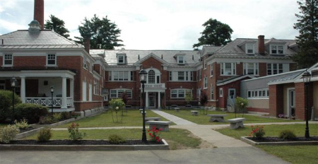
Why Community Integrated Academy Training?
Before recruits enter the public sphere, so it is truly a part of their baseline training for the job instead of an on-the-job adaptation after impressions have been made.
Helps shape perspective of job, encourages “team” effort for the benefit of society as a whole.
Diversify educational opportunities– training via human interaction and personal connections. Practical vs. Textbook
Fosters Institutional commitment to incorporating community opinion
The Earlier the Better.
I.e District of Columbia Public Schools have started a programs for a law-enforcement career path to encourage “homegrown” recruits that will be aware of area’s culture and needs.

Slide 7
Course Curriculum
Vermont Police Academy Training for Full-time Police Officers:
Level III Basic Training (16 weeks residential training + 2-3 weeks post-basic training)
Currently Level III Basic Training requires 34.5 Hrs of courses in “Police Demeanor” Training
Currently Includes: 8hrs of Community Police Training, 4hrs Fair & Impartial Policing, 8hr Police Ethics etc...
Current Total “Police Demeanor” Training comprises only 5% of the Level III Basic Training Curriculum.
P-CITE would be a new 2-Part Course: One for dialogue on procedural issues, and one for dialogue on cultural issues.
1) Police- Community Constitutional Law Discussions (Two 3hr Courses)
2) Police-Community Forum Discussions (Three 3hr Forums)
Total: Addition of 15hrs (~50% increase) of required P-CITE training with the community as part of “Police Demeanor” Training
Key Point: FOR the benefit of society, which means BOTH voices need to be heard

Slide 8
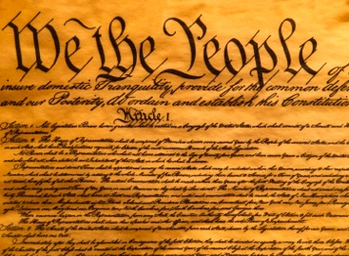
1. Constitutional Law 101 – Two Perspectives
While Police Trainees will have covered such procedural issues in an academic setting, they will get the benefit of hearing perspectives on how they play out in a practical and personal way.
Hearing from “the People”
Constitutional Infringement, or perceived constitutional infringement evokes strong emotional responses, crucial to understand these emotions.
Key Constitutional Issues:
Due Process
4th Amendment
Lawful Arrests
Rights and Liberties during Police Interactions

Slide 9
2. Group discussion forums - Through the looking glass
Forum to Listen to Ex-Offenders and Community Leaders about Needs and Challenges Faced by the Community
BOTH the Police and Community to voice concerns and suggestions directly
3 forums with a moderator/arbitrator:
Impressions – Police (3hrs)
Impressions – Community (3hrs)
Solutions/Putting it All Together – Combined Discussion (3hrs)

Slide 10
Why?
Ultimately the power lies in the people, pay for government services, and they should have a direct voice heard in what is expected on a human to human level.
Training for the benefit of society, not just the benefit of police or the community.
Benefits:
Increased Trust (actions speak louder than words, shows commitment).
Familiarity between Community and Police and Vis Versa.
Facilitates Ease of Tensions, Promoting more Amicable Interactions (less escalation).
Fosters Personal Connections
Direct Engagement Between Police and Community.
Developing Problems Can Be Identified Before They Reach a Boiling Point.
Incoming Police are Aware of their Community.
Broadens Understanding and Fosters Feeling of Investment with the Community.

Slide 11
Some Challenges?
Keeping the Distinction between Technical Training and “Demeanor” Training
Technical training better left to Police Academy
Getting Sincere Community Participants
Could be offered as part of a “community service” option for non-violent offenders?
Vetting those with personal vendettas or who want to berate/lecture/agitate the police

Slide 12
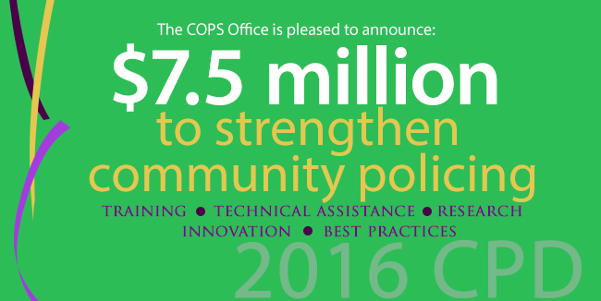
Funding?
USDOJ Community Oriented Policing Grants (USDOJ- COPS)
FY 2016 $7.5 million available for Community Police Development Programs (CPD).

Slide 13
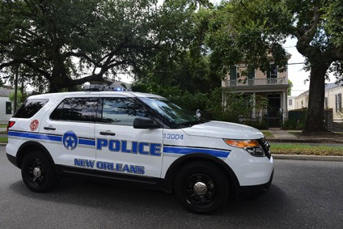
Innocence Project and the New Orleans Police Department (NOPD) – Innocence 101
Louisiana has 2nd Highest Rate of Exonerated Wrongful Convictions
NOPD Training Academy and Innocence Project – 3hr Program
Detectives and Innocence Project Leaders
Federal Monitors have praised the NOPD Wrongful Conviction Program
“The topic was important, the instruction was impressive, and the exercises were instructive.”
Example of Shift towards these engaging the subjects of police encounters as a method of training.

Slide 14
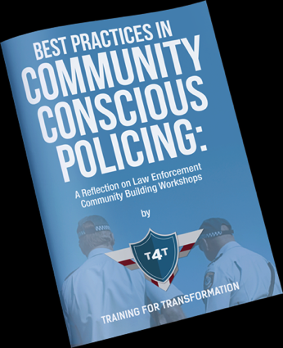
School of International Training (SIT) Graduate Institute Alumni Brandon Lee
“Bringing those together who may not otherwise have come together” – Brandon Lee (MA in Teaching SIT ‘11)
When the stakes are high, everyone will benefit from having a better understanding of the situation.
Training for Transformation (T4T)
Worked with Corvallis, Oregon Law Enforcement

Slide 15
How to Measure Success of Community Policing?
2005 Government Accountability Office (GAO) Study
USDOJ COPS funding resulted in decreases in crime
Concluded that community policing expenditures were responsible for 10% of the total decrease in crimes between 1993-1998 (old, but telling)

Slide 16
Corvallis, Oregon Community Building Workshop with Training for Transformation (T4T): Participant Testimonials
“This was the first time I’ve shook an officers hand and heard about their families.”
“I am glad I got to speak. I’m glad others got to speak”
“I really enjoyed hearing the police officers talk about how they view the community and their work.”

Slide 17
Questions?
Matthew Carr JD/MELP 2017
MatthewCarr@vermontlaw.edu

