Slide 1
NHMLA Seminar on Takings and Exactions
John D. Echeverria
Vermont Law School
February 26, 2014
Concord, N.H.

Slide 2
What’s a Taking?
“Nor shall private property be taken for public use, without just compensation.”

Slide 3
What’s a Taking?
“Nor shall private property be taken for public use, without just compensation.”

Slide 4
What’s a Taking?
“Nor shall private property be taken for public use, without just compensation.”

Slide 5
What’s a Taking?
“Nor shall private property be taken for public use, without just compensation.”

Slide 6
What’s a Due Process violation?
“No person shall be . . . deprived of life, liberty, or property, without due process of law.”

Slide 7
Types of Takings Claims

Slide 8
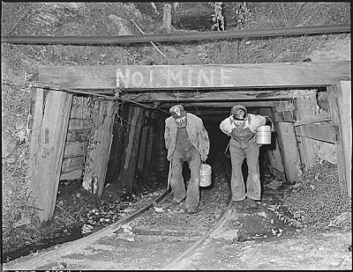
Types of “Inverse” Takings Claims
Direct appropriations and permanent physical occupations = per se takings.

Slide 9
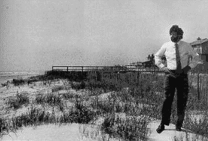
Types of “Inverse” Takings Claims
Regulatory takings claims:
-- Total denials of all value = Lucas per se takings.

Slide 10
Types of “Inverse” Takings Claims
Regulatory takings claims:
-- Total denials of all value = Lucas per se takings.
-- Lesser but still substantial restrictions on property use = potential Penn Central takings, depending on
(a) the level of economic impact,
(b) the degree of interference with investment-backed expectations,
(c) and the character of the government action.

Slide 11
Types of “Inverse” Takings Claims
Direct appropriations and permanent physical occupations = per se takings.
Most other inverse condemnation claims:
-- Total denials of all value = Lucas per se takings.
-- Lesser but still substantial restrictions on property use = potential Penn Central takings, depending on the level of economic impact, the degree of interference with investment-backed expectations, and the character of the government action.
Nollan, Dolan and now Koontz “exaction” claims.

Slide 12
Types of “Inverse” Takings Claims
The alleged failure of a government action to “substantially advance” a legitimate govern-mental interest cannot support a claim under the Takings Clause
Instead, such allegations can only state a potential claim under the Due Process Clause
Lingle v. Chevron, USA (2005)

Slide 13
Types of “Inverse” Takings Claims
Two part analysis:
Is there property ?
Has it been taken?

Slide 14
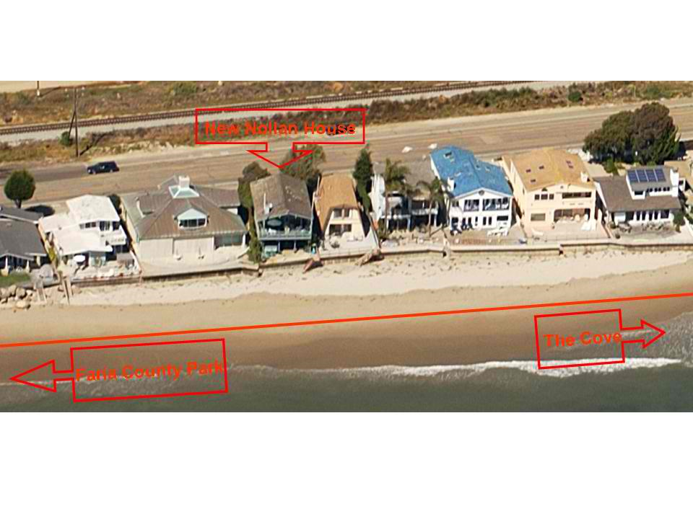
Nollan v. CA Coastal Comm’n, 1987

Slide 15
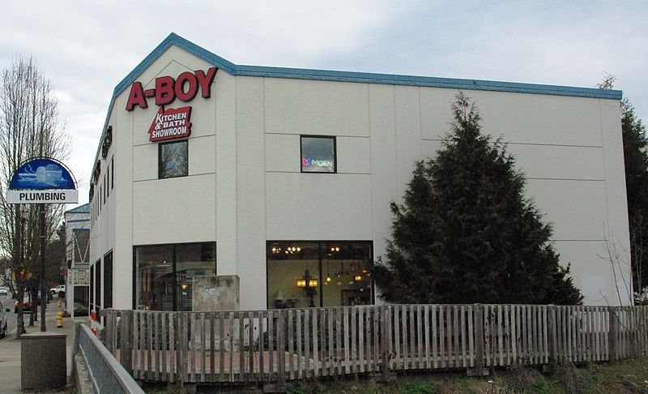
Dolan v. City of Tigard, 1994

Slide 16
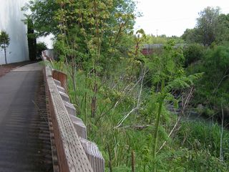
Dolan v. City of Tigard, 1994

Slide 17
The Nollan/Dolan Question
If the government had simply denied the Nollans’ or Mrs. Dolan’s application, there clearly would NOT have been a taking of the properties under either Lucas or Penn Central.
On the other hand, if the government had directly appropriated the beach easement in Nollan, or the bike path/greenway in Dolan, there clearly would have been a per se taking.
So what standard applies when the government grants a permit (which it could have denied without triggering takings liability), on the condition that the applicant grant the government an interest in property which the government could have taken directly only if it were willing to pay just compensation under the Takings Clause?

Slide 18
The Nollan/Dolan Standards
An exaction of a property interest in the context of a permitting process is not a taking, provided the exaction meets:
(a) the “essential nexus” test (Nollan), and
(b) the “rough proportionality” (Dolan) test.
Otherwise, a permit exaction is a taking.

Slide 19
Essential Nexus/Nollan
“The Commission argues that a permit condition that serves the same legitimate police power purpose as a refusal to issue the permit should not be found to be a taking if the refusal to issue the permit would not constitute a taking. We agree.”
“The evident constitutional propriety disappears, however, if the condition substituted for the prohibition utterly fails to further the end advanced as the justification for the prohibition. When that essential nexus is eliminated . . . [there is taking of the exacted property interest].”
Holding: requirement of public access along the beach lacked essential nexus with regulatory purpose to preserve visual access across the beach.

Slide 20
Rough Proportionality/Dolan
“The second part of our analysis requires us to determine whether the degree of the exactions demanded by the city's permit conditions bear the required relationship to the projected impact of petitioner's proposed development.”
“We think a term such as ‘rough proportionality’ best encapsulates what we hold to be the requirement of the Fifth Amendment. No precise mathematical calculation is required, but the city must make some sort of individualized determination that the required dedication is related both in nature and extent to the impact of the proposed development.”
Result: Case remanded for application of “rough proportionality” test.

Slide 21
Under Nollan and Dolan, Burden of Proof is Placed on the Public!
Dolan footnote 8: “Justice Stevens' dissent takes us to task for placing the burden on the city to justify the required dedication. He is correct in arguing that in evaluating most generally applicable zoning regulations, the burden properly rests on the party challenging the regulation to prove that it constitutes an arbitrary regulation of property rights. See, e.g., Euclid v. Ambler Realty Co., 272 U.S. 365 (1926). Here, by contrast, the city made an adjudicative decision to condition petitioner's application for a building permit on an individual parcel. In this situation, the burden properly rests on the city.”

Slide 22
Some Key Issues After Nolan/Dolan
Are exactions imposed through general legislation (or general rules?), rather than in ad hoc proceedings, subject to Nollan/Dolan?
Do Nollan/Dolan extend to “monetary exactions,” especially following the five-justice conclusion in Eastern Enterprises (1998), that government mandates to spend or pay money are outside the scope of the Takings Clause?
What does it take (in terms of proof and analysis) to successfully defend an exaction under the Nollan/Dolan standards?

Slide 23
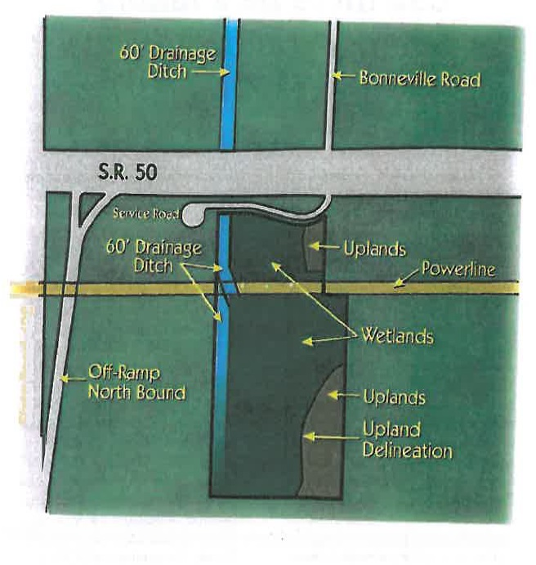
And then Koontz

Slide 24
Koontz: Basic Facts I
Koontz purchased a 14.9-acre parcel east of Orlando, FL in 1972 for approximately $95,000.
In 1987, a transportation agency took 0.7 acres of Koontz’s property, paying $402,000 in compensation for the land taken as well as “severance” damages.
In 1994, Koontz filed an application for permits to develop 3.7 acres of the remaining property, including 3.4 acres of wetlands, in order to construct a small commercial shopping center.
Koontz proposed to address the District’s requirement to avoid adverse environmental impacts by placing deed restrictions on the remaining 11 acres of the property; the District rejected this proposal based on the 10:1 preservation ratio in its guidelines.

Slide 25
Koontz: Basic Facts II
The District suggested that Koontz consider reducing the size of the development to one acre, or accomplish further mitigation by restoring wetlands on District-owned property in the basin by paying to replace culverts and/or fill ditches; Koontz rejected these options.
The District denied Koontz’s application.
In 1994, Koontz filed suit in Florida Circuit Court claiming a taking of his private property.
After considerable procedural wrangling, the trial court ruled that the District’s permit denial was a taking and awarded compensation.

Slide 26
Koontz: Basic Facts III
The District then granted Koontz the permits; Koontz sold the permitted property to Floridel, LLC for $1,200,000; Floridel LLC never developed the property and filed for Chapter 11 Bankruptcy in 2013.
The litigation continued solely on the issue of whether the District should be held liable for a “temporary” taking of private property.
In 2009, the Florida Fifth District Court of Appeals affirmed, 2-1, the trial court finding of takings liability.
In 2011, the Florida Supreme Court reversed, holding that Nollan and Dolan do not apply when, as in this case, (1) a permit is denied (as opposed to when a permit is granted subject to conditions) and (2) the conditions involve the payment or expenditure of money (as opposed to when the conditions involve dedication of a right of way or another interest in real property).

Slide 27
The Legal Issues in the Supreme Court
Whether the Nollan/Dolan standards apply when the government denies a development application because the applicant has refused to accede to a government “demand” that the applicant comply with a requirement that would trigger Nollan/Dolan if it were made a condition of project approval?
Whether the Nollan/Dolan standards apply to so-called “monetary exactions” -- permit conditions requiring permittees to pay or expend money to mitigate project impacts?

Slide 28
The Court Decision – Issue #1
The justices agreed that Nollan/Dolan apply regardless of whether the government approves a permit subject to an exaction (a condition subsequent) or rejects an application because the applicant refuses to accede to a “demand” for an exaction (a condition precedent) .
The Court stated that a permit denial in a Koontz –type case does not constitute a taking, but instead is a “Nollan/Dolan unconstitutional conditions violation.”
The majority assumed, without actually deciding the issue, that there was a “demand” in this case, because the Florida courts assumed there was a demand.
The four dissenters said there was no demand because the District merely offered “suggestions” and the applications were denied based on the unacceptable effects of the project.

Slide 29
The Court Decision – Issue #2
The Court ruled 5-4 that the Nollan/Dolan standards are not limited to exactions involving an interest in real property, but also apply to “monetary exactions” – i.e., permit requirements to expend or pay money.
Without contesting the position embraced by five justices in Eastern Enterprises that mandates to pay money are not generally covered by the Takings Clause, the majority ruled that the Takings Clause does apply to government orders “directing the owner of a particular piece of property to make a monetary payment.”
The dissent contends that the ruling (1) is inconsistent with the logic of Nollan and Dolan, (2) will extend the Takings Clause “into the very heart of local land-use regulation and service delivery,” and (3) logically converts all real property taxes into takings (although the majority says the ruling is not intended to reach that far).

Slide 30
Types of Monetary Exactions
--Transportation
-- Parkland
-- Affordable Housing
-- Wetlands Mitigation
-- Agricultural Lands
-- Schools
Notes:
t

Slide 31
Questions about the Scope of Koontz
What is a “demand”? How “definite, concrete and specific” does a demand have to be to become a “demand” under Koontz?
Can taxes and user fees be takings, and if so when?
Are legislative exactions, including legislative fees, subject to a different, more deferential standard of review than ad hoc exactions?
How are communities supposed to demonstrate compliance with the essential nexus and rough proportionality tests, especially with respect to exactions that have are merely being proposed?

Slide 32
Whither Takings Law After Koontz?
5/4 Court split on monetary exactions is inherently unstable
While apparently in agreement on “failed exactions,” the Court seems to be split on the rationale
Does Koontz portend revival of “substantially advance” takings test?
Does Koontz portend more exacting judicial review of local land use regulation generally?
Will the Court reverse course as it did in Lingle?

Slide 33
What to Make of Koontz?
“Koontz: The Very Worst Takings Decision Ever?”
John Echeverria
NYU Environmental Law Review
(forthcoming)

Slide 34
APA Reaction to Koontz
CHICAGO — “The American Planning Association (APA) is disappointed with the U.S. Supreme Court's decision in Koontz v. St. Johns River Water Management District. The 5-4 decision is an unnecessary blow to state and local governments attempting to reduce development impacts on the environment as well as engage in good-faith discussions with landowners to determine appropriate mitigation efforts.”
“The decision expands the "essential nexus" and "rough proportionality" takings tests of the Court's previous decisions in Nollan v. California Coastal Commission (1987) and Dolan v. City of Tigard (1994).”
Notes:
t

Slide 35
APA Reaction to Koontz
“The Court's decision today has jeopardized local governments' ability to ensure that the costs of new development are fairly born by its developers and users," said W. Paul Farmer, FAICP, CEO of the American Planning Association. "The decision will instill fear in local agencies to even begin mitigation discussions with landowners and discourages them from seeking ways to allow development to actually proceed. The four dissenting justices suggest one course of action: 'Deny the permits.' The majority decision leaves no one certain of which discussions — or required payments — may be subject to heightened scrutiny."
Notes:
t

Slide 36
Promising Snippets for Government Defendants . . .
-- “[M]any proposed land uses threaten to impose costs on the public that dedications of property can offset.”
--“Insisting that landowners internalize the negative externalities of their conduct is a hallmark of responsible land-use policy, and we have long sustained such regulations against constitutional attack. See Village of Euclid v. Ambler Realty Co.”
--“Our precedents . . . enable permitting authorities to insist that applicants bear the full costs of their proposals.”

Slide 37
Why is Koontz so darn awful?
Legally incoherent.
Negative practical implications for communities and developers alike.

Slide 38
Legal Incoherence of Applying Nollan/Dolan to Monetary Fees
Predicate for applying Nollan/Dolan is that condition, considered independently, would constitute a per se taking.
Imposition of generalized financial liability is not a taking under Eastern Enterprises.
The “direct link” between the condition and a specific piece of real estate cannot by itself justify applying Nollan/Dolan.
Nor does the direct link justify treating a fee as a per se taking and, if it did, a fee condition would be a per se taking, not a potential taking under Nollan and Dolan.

Slide 39
Legal Incoherence of Applying Nollan/Dolan to Monetary Fees
Is the Court really applying an ersatz version of the discredited substantially advance takings test?
“[T]his case implicates the central concern of Nollan and Dolan: the risk that the government may use its substantial power and discretion in land-use permitting to pursue governmental ends that lack an essential nexus and rough proportionality to the effects of the proposed new use of the specific property at issue, thereby diminishing without justification the value of the property.”

Slide 40
Legal Incoherence of Applying Nollan/Dolan to Permit Denials
Nollan and Dolan are built on the premise that if the government chooses to address the external effects of development by denying a permit, the regulatory takings standards will apply -- so regulatory takings standards should apply when the government denies a permit.
Nollan and Dolan provide tests for determining whether an exaction amounts to a taking – and cannot logically apply if no exaction has been imposed.

Slide 41
Legal Incoherence of Applying Nollan/Dolan to Permit Denials
The unconstitutional conditions doctrine does not justify applying Nollan/Dolan to a permit denial:
-- The Court has recognized that Nollan and Dolan are a “special application” of the unconstitutional conditions doctrine -- which recognizes that a different test applies to denial of a permit than to the imposition of an exaction.
-- The unconstitutional conditions doctrine cannot make up for the fact that a permit denial involves no exaction that triggers Nollan/Dolan.

Slide 42
What are Practical Implications of Koontz?
“For the folks in this country and Florida . . . , it will give them a bigger stick to take into court in the future to fight these types of cases.”
- Coy Koontz, Jr., quoted in
Greenwire (June 26, 2013)

Slide 43
Practical Implications of Koontz Ruling on Fees
-- Will lead to more intrusive judicial second guessing of local land use decisions.
-- Will lead to more cumbersome, time consuming, expensive local administrative proceedings.
-- Will lead to more litigation.
-- Will likely lead to more unmitigated adverse effects from development on communities.
-- The costs of regulatory delays and preparing nexus/rough proportionality studies will likely ultimately fall on developers. (What were they thinking in supporting Koontz?)

Slide 44
Practical Implications of Koontz Ruling on Permit Denials
-- Will lead to more intrusive judicial second guessing of local land use decisions.
-- Will lead to more cumbersome, time consuming, expensive local administrative proceedings.
-- Will lead to more litigation.
-- Will likely lead to more unmitigated adverse effects from development on communities.
-- The costs of regulatory delays and preparing nexus/rough proportionality studies will likely ultimately fall on developers. (What were they thinking in supporting Koontz?)

Slide 45
Practical Objections to Koontz Ruling on Permit Denials
-- Will impose burdensome requirement on local officials, if they wish to engage in serious negotiations with developers, to conduct elaborate analyses of potential exactions before even proposing them.
-- In litigation involving potentially enormous municipal liability, will impose impractical requirement on local officials to justify, sometimes years after the fact, conditions that they decided not to impose and that may not have been spelled out in detail

Slide 46
Practical Objections to Koontz Ruling on Permit Denials
-- Will lead to more frequent application denials:
“If a local government risked a lawsuit every time it made a suggestion to an applicant about how to meet permitting criteria, it would cease to do so; indeed, the government might desist altogether from communicating with applicants. That hazard is to some extent baked into Nollan and Dolan . . . . But that danger would rise exponentially if something less than a clear condition—if each idea or proposal offered in the back-and-forth of reconciling diverse interests—triggered Nollan-Dolan scrutiny. At that point, no local government official with a decent lawyer would have a conversation with a developer. Hence the need to reserve Nollan and Dolan, as we always have, for reviewing only what an official demands, not all he says in negotiations.”
-- Kagan J., in dissent

Slide 47
Local Government options after Koontz
1. Negotiate and run risk that proposals rejected by developer will provide basis for Koontz suit
2. Don’t negotiate - deny or approve as proposed
3. Facilitate negotiation of land use permit to developer and private stakeholders
4. Negotiate without stating positions
5. Negotiate but never articulate a position that is “definite, concrete or specific”
6. Attempt to insulate pre-application negotiations from Koontz – not very promising!
7. Invite litigation and attempt to resolve permit conditions through confidential litigation settlement process (!!)
Notes:
t

Slide 48
Advice
Administrative Process:
Assess vulnerability of municipal land use processes and standards to Nollan, Dolan and Koontz challenges
If community decides to reject a development proposal, articulate rationale solely in terms of unacceptable adverse impacts of proposal
Implement exactions policy through carefully supported general legislation to the extent possible
Don’t propose and don’t negotiate over exactions!!
Notes:
t

Slide 49
Advice
Litigation Process:
Defend legislative vs ad hoc distinction
Argue for a strict definition of a “demand”
Argue that Koontz is properly viewed as a due process case
and, accordingly, a deferential standard of review should apply in a Koontz-type challenges to a permit denial
Notes:
t

Slide 50
Thank You
Questions?
Notes:
t

